Slide 1

ARS in Action: An implementation in R
Malan Bosman – ICON Strategic Solutions (ISS)

Slide 2
Introduction

Slide 3
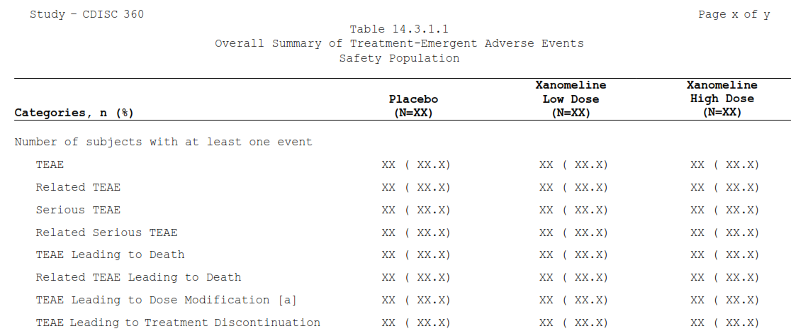
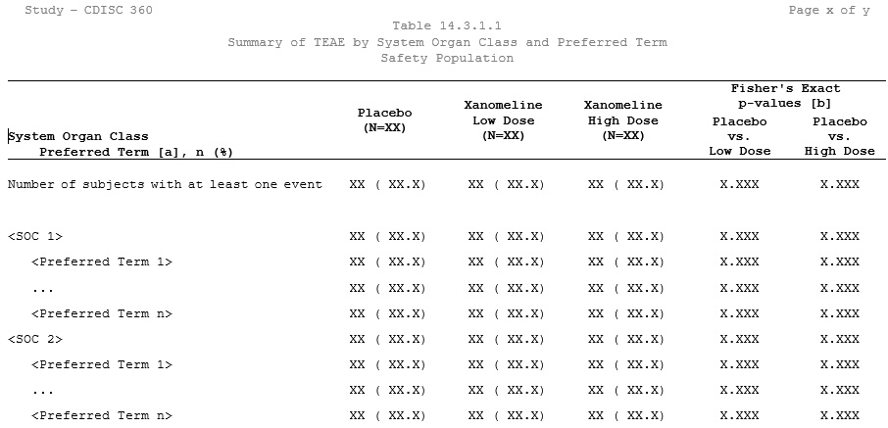
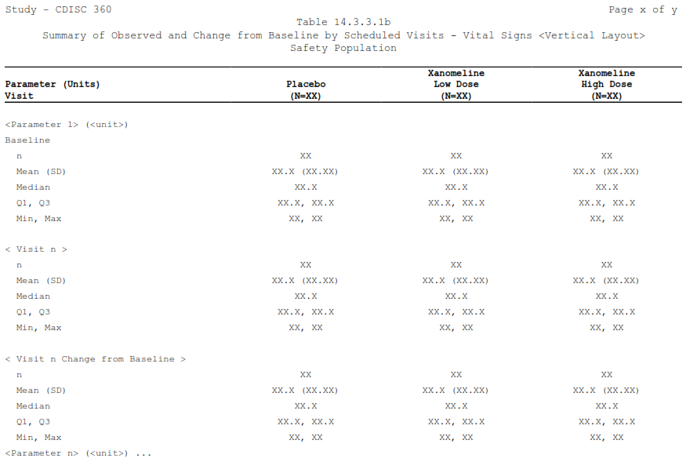
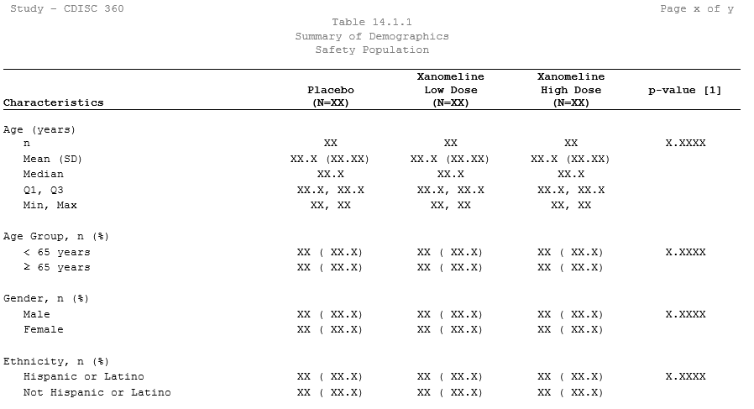
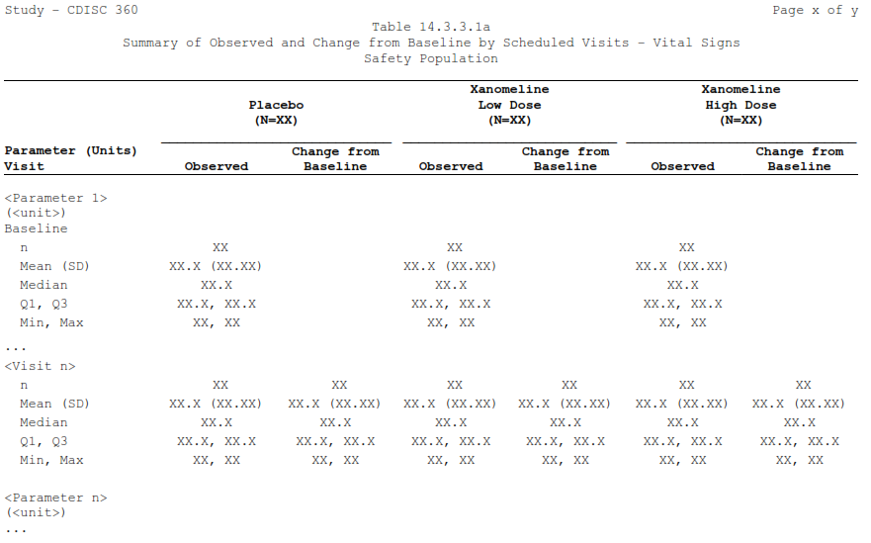
What if I told you…
each result

Slide 4
What if I told you…
each result
for all outputs in a study

Slide 5
What if I told you…
each result
for all outputs in a study
Can be calculated…

Slide 6

What if I told you…
each result
for all outputs in a study
Can be calculated…
with one click

Slide 7
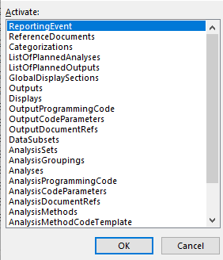
What if I told you…
each result
for all outputs in a study
Can be calculated…
with one click
referencing only metadata

Slide 8

What if I told you…
each result
for all outputs in a study
Can be calculated…
with one click
referencing only metadata
using open-source technology

Slide 9

What if I told you…
each result
for all outputs in a study
Can be calculated…
with one click
referencing only metadata
using open-source technology
Now, it’s possible!

Slide 10
Process overview

Slide 11
Process overview
Study documents
ARS Model
Results
Outputs / Display

Slide 12
Process overview
Study documents
ARS Model
Results
Outputs / Display

Slide 13
Process overview
SAP
Study documents
ARS Model
Results
Outputs / Display
Shells
Protocol

Slide 14
Process overview
SAP
Study documents
ARS Model
Results
Outputs / Display
Shells
Protocol

Slide 15
Process overview
SAP
Study documents
ARS Model
Results
Outputs / Display
Shells
Protocol

Slide 16
Process overview
Contains metadata to produce results
- e.g. Excel workbook
SAP
Study documents
ARS Model
Results
Outputs / Display
Shells
Protocol

Slide 17
Process overview
Contains metadata to produce results
- e.g. Excel workbook
SAP
Study documents
ARS Model
Results
Outputs / Display
Shells
Protocol

Slide 18
Process overview
Contains metadata to produce results
- e.g. Excel workbook
SAP
Study documents
ARS Model
Results
Outputs / Display
Shells
Protocol
“Engine”

Slide 19
Process overview
Contains metadata to produce results
- e.g. Excel workbook
SAP
Study documents
ARS Model
Results
Outputs / Display
Shells
Protocol
“Engine”

Slide 20
Process overview
Single dataset containing all results
Study documents
ARS Model
Results
Outputs / Display
SAP
Shells
Protocol
Contains metadata to
produce results
- e.g. Excel workbook
“Engine”

Slide 21
Process overview
Single dataset containing all results
Study documents
ARS Model
Results
Outputs / Display
SAP
Shells
Protocol
Contains metadata to
produce results
- e.g. Excel workbook
“Engine”

Slide 22
Process overview
Single dataset containing all results
Study documents
ARS Model
Results
Outputs / Display
SAP
Shells
Protocol
Contains metadata to
produce results
- e.g. Excel workbook
“Engine”
Conversion tool

Slide 23
Process overview
Single dataset containing all results
Study documents
ARS Model
Results
Outputs / Display
SAP
Shells
Protocol
Contains metadata to
produce results
- e.g. Excel workbook
“Engine”
Conversion tool

Slide 24
Process overview
Single dataset containing all results
Static or interactive
Study documents
ARS Model
Results
Outputs / Display
SAP
Shells
Protocol
Contains metadata to
produce results
- e.g. Excel workbook
“Engine”
Conversion tool

Slide 25
Process overview
Study documents
ARS Model
Results
Outputs / Display
Convert / reshape
populate
calculate

Slide 26
Hackathon project: ARS in action

Slide 27
Hackathon project
SAP / Mock-up shells
Standard TFL Templates
Prospective!
Reporting Event
(CSR, DSUR, IB, etc.)
Analyses of Interest
Analysis Results Metadata (Technical Specs)
ADaM Specs & Programming
Design & Specify
Machine-readable!
JSON, Excel, YAML, etc.
CSR Publishing
RTF/PDF/HTML
Machine-readable!
Specs Ingestion
Outputs / Displays
JSON,SAS,R,YAML, etc.
Analysis Results Data (ARD)
Analysis Programming
ADaM
Automation Engine
Data Visualization
Results along with Metadata
Automation Engine
SAS / R / Python

Slide 28
Hackathon project
SAP / Mock-up shells
Standard TFL Templates
Prospective!
Reporting Event
(CSR, DSUR, IB, etc.)
Analyses of Interest
Analysis Results Metadata (Technical Specs)
ADaM Specs & Programming
Design & Specify
Machine-readable!
JSON, Excel, YAML, etc.
CSR Publishing
RTF/PDF/HTML
Machine-readable!
Specs Ingestion
Outputs / Displays
JSON,SAS,R,YAML, etc.
Analysis Results Data (ARD)
Analysis Programming
ADaM
Automation Engine
Data Visualization
Results along with Metadata
Automation Engine
SAS / R / Python

Slide 29
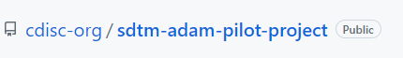
Hackathon project
Example study:

Slide 30
Hackathon project
Example study:
Objective:
Calculate all results (formatted) required for the safety outputs

Slide 31
Hackathon project
Example study:
Objective:
Calculate all results (formatted) required for the safety outputs
1. Demographics table

Slide 32
Hackathon project
Example study:
Objective:
Calculate all results (formatted) required for the safety outputs
2. Summary of Treatment-Emergent Adverse Events

Slide 33
Hackathon project
Example study:
Objective:
Calculate all results (formatted) required for the safety outputs
3. Summary of TEAE by System Organ Class and Preferred Term

Slide 34
Hackathon project
Example study:
Objective:
Calculate all results (formatted) required for the safety outputs
4. Summary of Observed and Change from Baseline by Scheduled Visits – Vital Signs

Slide 35
Documents -> Model
Study documents
ARS Model
Results
Outputs / Display

Slide 36
Documents -> Model
Study documents
ARS Model
Results
Outputs / Display

Slide 37
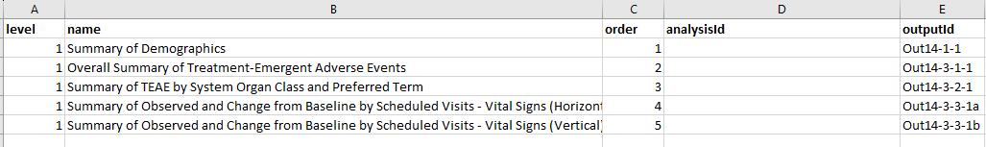
Documents -> Model
Study documents
ARS Model
Results
Outputs / Display

Slide 38
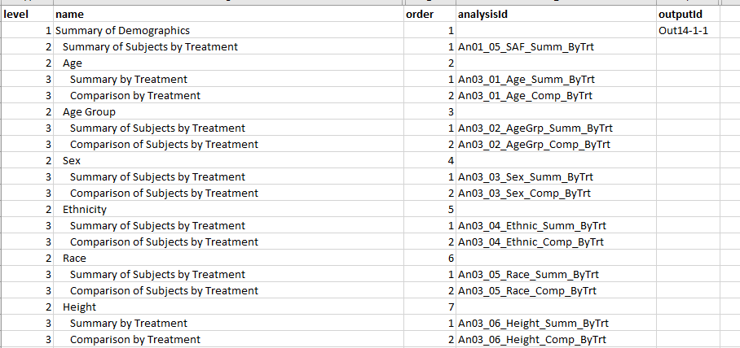
Documents -> Model
Study documents
ARS Model
Results
Outputs / Display

Slide 39
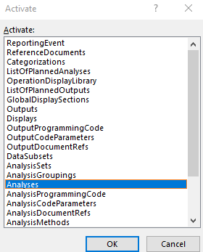
Documents -> Model
Study documents
ARS Model
Results
Outputs / Display

Slide 40
Documents -> Model
Study documents
ARS Model
Results
Outputs / Display

Slide 41
Documents -> Model
Study documents
ARS Model
Results
Outputs / Display

Slide 42
Documents -> Model
Study documents
ARS Model
Results
Outputs / Display

Slide 43
Documents -> Model
Study documents
ARS Model
Results
Outputs / Display

Slide 44
Model -> Results
Study documents
ARS Model
Results
Outputs / Display

Slide 45
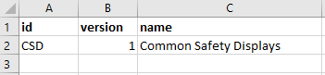
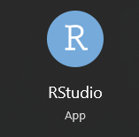
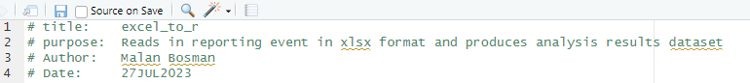
Model -> Results
Study documents
ARS Model
Results
Outputs / Display
Method used:
“Common Safety displays.xlsx”

Slide 46
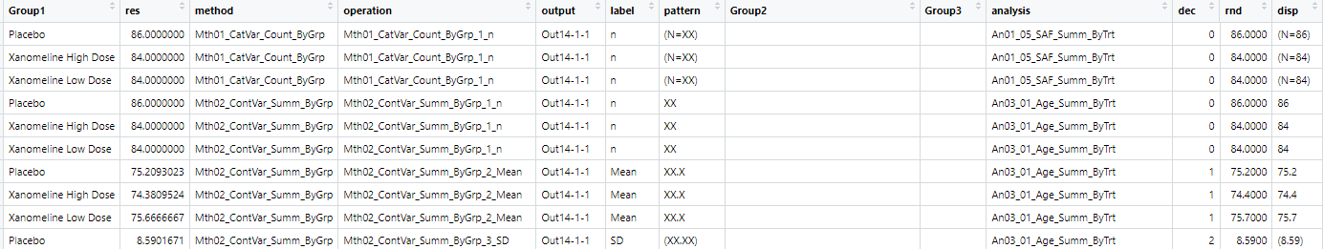
Model -> Results
Study documents
ARS Model
Results
Outputs / Display
Method used:
“Common Safety displays.xlsx”
Results dataset

Slide 47
Model -> Results
Study documents
ARS Model
Results
Outputs / Display
Method used:
“Common Safety displays.xlsx”
Results dataset

Slide 48
Model -> Results
Study documents
ARS Model
Results
Outputs / Display
Method used:
“Common Safety displays.xlsx”
Results dataset

Slide 49
Model -> Results
Study documents
ARS Model
Results
Outputs / Display
Method used:
“Common Safety displays.xlsx”
Results dataset

Slide 50
Model -> Results
Study documents
ARS Model
Results
Outputs / Display
Method used:
“Common Safety displays.xlsx”
Results dataset

Slide 51
Model -> Results
Study documents
ARS Model
Results
Outputs / Display
Method used:
“Common Safety displays.xlsx”
Results dataset

Slide 52
Model -> Results
Study documents
ARS Model
Results
Outputs / Display
Method used:
“Common Safety displays.xlsx”
Results dataset

Slide 53
Model -> Results
Study documents
ARS Model
Results
Outputs / Display
Method used:
Highlights:

Slide 54
Model -> Results
Study documents
ARS Model
Results
Outputs / Display
Method used:
Highlights:
Performs groupings
Subsets data
Basic method: Nested loops through “ListOfPlannedAnalyses”,
then each Operation linked to the AnalysisMethod (linked to each Analysis)
Chunk of code performing each operation appends rows after each operation to create Analysis Results dataset
Applies correct pattern / format to result

Slide 55
Results -> Outputs / display
Study documents
ARS Model
Results
Outputs / Display

Slide 56
Results -> Outputs / Display
Study documents
ARS Model
Results
Outputs / Display
Static

Slide 57
Results -> Outputs / Display
Study documents
ARS Model
Results
Outputs / Display
Static
Interactive

Slide 58
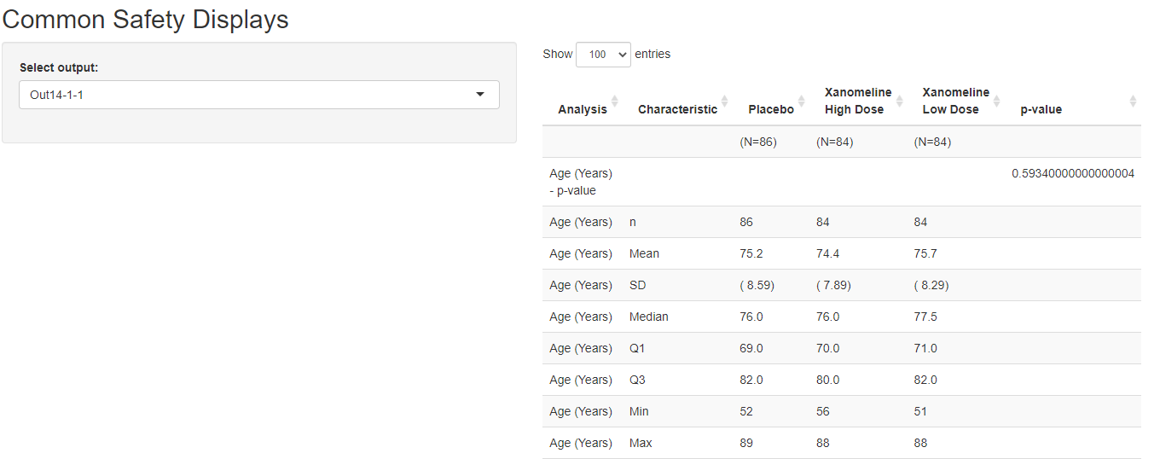
Results -> Outputs / Display
Study documents
ARS Model
Results
Outputs / Display
Basic R-Shiny app:

Slide 59
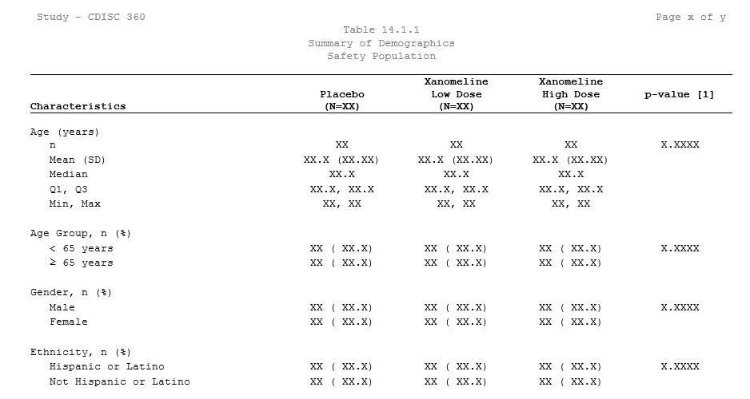
Results -> Outputs / Display
Study documents
ARS Model
Results
Outputs / Display
Shell:
Basic R-Shiny app:

Slide 60
Results -> Outputs / Display
Study documents
ARS Model
Results
Outputs / Display
Shell:
Basic R-Shiny app:

Slide 61
Concluding thoughts

Slide 62
Concluding thoughts
Automation
Aim for automation
Across industry
Open-source
Quicker adoption
Easier collaboration
User Experience
Make it a priority
Part of design

Slide 63
Next steps:
Study documents
ARS Model
Results
Outputs / Display

Slide 64
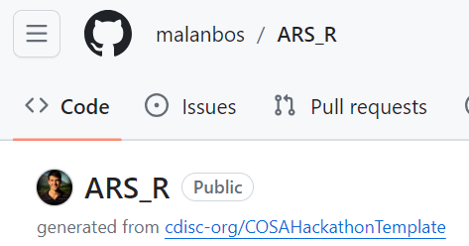
Github repo:
E-mail: Malan.bosman@iconplc.com

Slide 65






ICONplc.com
© 2023 ICON. All rights reserved.

